Slide 1
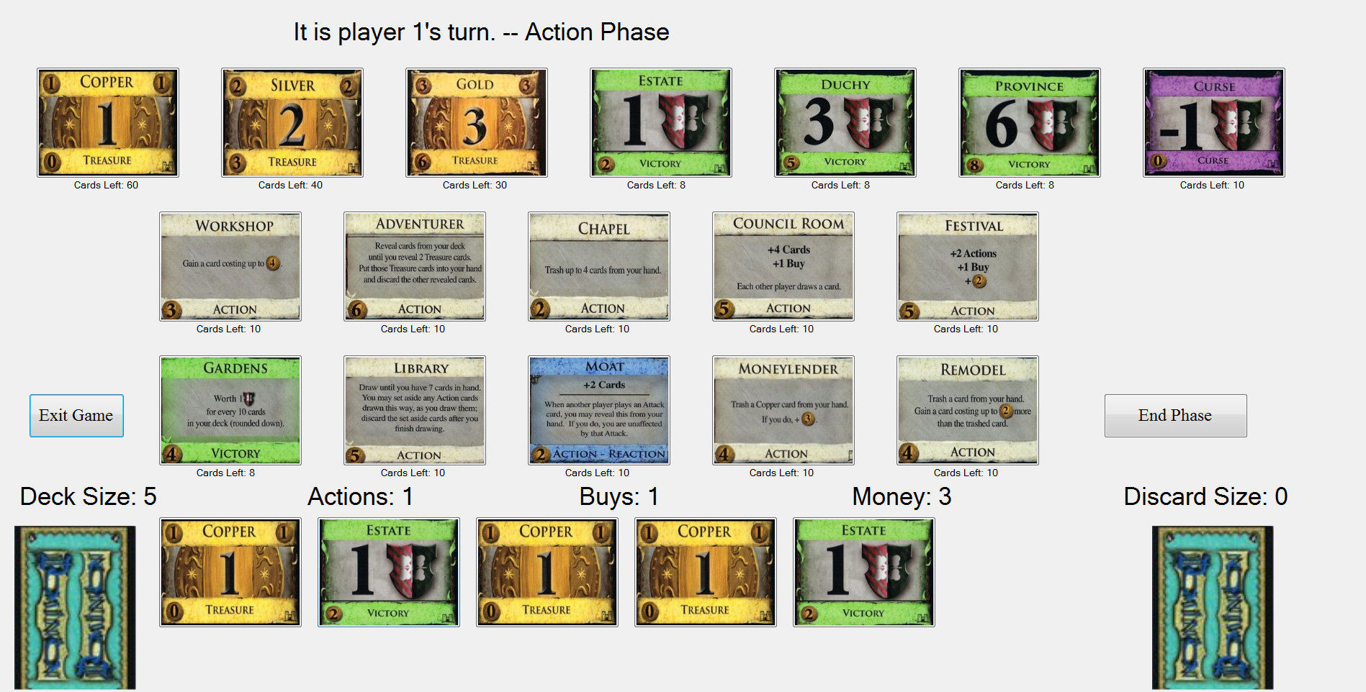
Dominion
By: Morgan Cook, Thomas Bonatti & Lujia Zhang

Slide 2
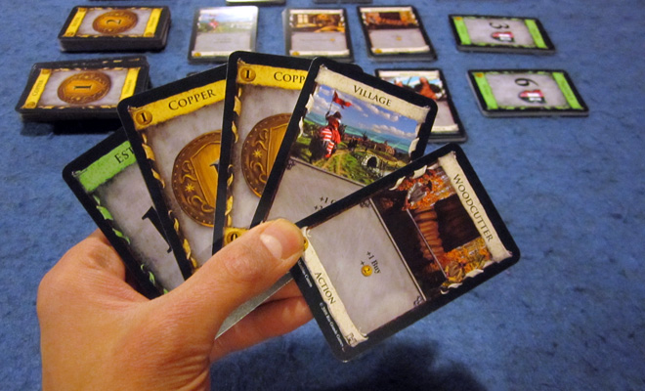
Game Play
Deck building game
Building up a city
Use cards to gain money to buy more cards
Shuffle, repeat

Slide 3
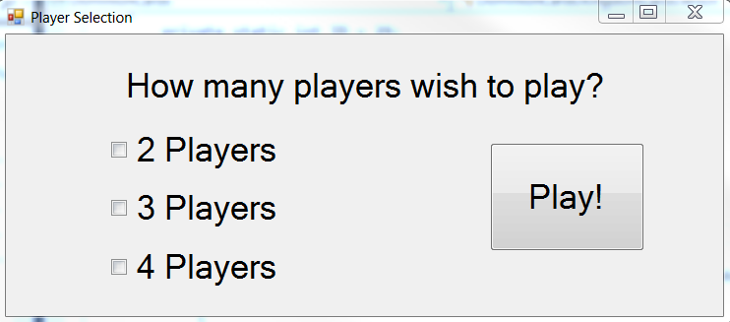
Features
2-4 players
10 randomly selected kingdom cards
Player can see his hand of cards
Player can select which card to play
Number of actions, buys and money will be modified based on which action card is played

Slide 4
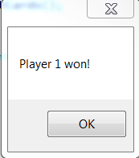
Features
Player can select which card(s) to purchase
Purchased card(s) are added to the player’s discard pile
Game automatically transfers to the next player
At the end of the game, the game will tally points and declare a winner or state which players tied

Slide 5

Testing Strategies Employed
White Box Testing
Unit Tests
Scripted Tests
Integration Tests
Mocking
System Tests
Exploratory Tests

Slide 6
Unit Tests
Most of the tests were unit tests
This unit test verifies that treasure cards return no victory points
[TestMethod]
public void testTreasureReturnsNoVP()
{
Card c = new Silver();
Assert.AreEqual(0, c.getVictoryPoints());
}

Slide 7
Scripted Tests
All of the cards that required user input were run as scripted tests
This scripted test verifies that when a person plays a thief and chooses to keep 1 card, that card goes into his discard pile
public void SetUp()
{
p1 = new HumanPlayer();
p2 = new HumanPlayer();
p3 = new HumanPlayer();
card = new Thief();
Dictionary<Card, int> dict = new Dictionary<Card, int>();
dict.Add(new Thief(), 10);
dict.Add(new Estate(), 10);
dict.Add(new Copper(), 60);
board = new GameBoard(dict);
board.AddPlayer(p1);
board.AddPlayer(p2);
board.AddPlayer(p3);
p2.getDeck().Push(new Copper());
p2.getDeck().Push(new Witch());
p3.getDeck().Push(new Gold());
p3.getDeck().Push(new Silver());
p1.addCardToHand(card);
} }
[TestMethod]
public void TestThatThiefKeepsSomeCards()
{
int discardCount = p1.getDiscard().Count;
p1.playCard(card);
Assert.AreEqual(discardCount + 2, p1.getDiscard().Count);
}

Slide 8
Integration Tests
Integration tests were frequently used because several components of the project relied heavily on one another
This integration test verifies that when a witch card is played, a curse is not added to the discard pile of the player who played the witch
[TestMethod]
public void TestWitchDoesNotAddCurseToMe()
{
Dictionary<Card, int> cards = new Dictionary<Card, int>();
cards.Add(new Curse(), 30);
GameBoard board = new GameBoard(cards);
Card c = new Witch();
Player p1 = new HumanPlayer(1);
Player p2 = new HumanPlayer(2);
Player p3 = new HumanPlayer(3);
board.AddPlayer(p1);
board.AddPlayer(p2);
board.AddPlayer(p3);
int cardsInDiscardp1 = p1.getDiscard().Count;
p1.addCardToHand(c);
p1.playCard(c);
Assert.AreEqual(cardsInDiscardp1 + 1, p1.getDiscard().Count);
Assert.IsFalse(p1.getDiscard().Contains(new Curse()));
}

Slide 9
Mocking
Mocking was used because players could not take turns in the unit tests
This test verifies that the game will end correctly by creating a mock of a player that draws a province card every turn until the game ends
public class SpecialPlayerMock : HumanPlayer
{
public int numbTimesCalled;
public SpecialPlayerMock() : base()
{
numbTimesCalled = 0;
}
public SpecialPlayerMock(int n) : base(n)
{
numbTimesCalled = 0;
}
public override void TakeTurn()
{
numbTimesCalled++;
GameBoard.getInstance().GetCards()[new Province()] -= 1;
getDiscard().Add(new Province());
}
}
[TestMethod]
public void IntegrationTestTieIsThrownOnTrueTieWithFivePlayers()
{
// MockRepository mocks = new MockRepository();
Dictionary<Card, int> cards = GetTestCards();
GameBoard board = new GameBoard(cards);
Player p1 = new SpecialPlayerMock(1);
Player p2 = new SpecialPlayerMock(2);
Player p3 = new SpecialPlayerMock(3);
Player p4 = new SpecialPlayerMock(4);
Player p5 = new SpecialPlayerMock(5);
board.AddPlayer(p1);
board.AddPlayer(p2);
board.AddPlayer(p3);
board.AddPlayer(p4);
board.AddPlayer(p5);
try
{
board.PlayGame();
}
catch (TieException e)
{
Assert.AreEqual(5, e.getArraySize());
return;
}
Assert.Fail("expected an exception");
}

Slide 10

Exploratory Testing
Exploratory testing was executed by playing through the game several times in an effort to find all of the bugs

Slide 11

Testing Strategies Not Employed
Black Box Testing
Mutation Testing
Fuzz Testing

Slide 12
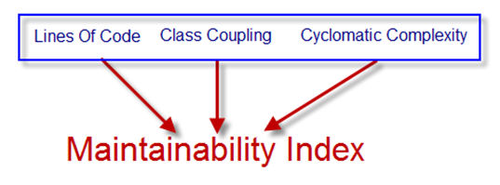
Thoroughness of Testing
Code Coverage: 93.63%
Maintainability Index: 72

Slide 13
DEMO
We will now run through a short game of Dominion

